Slide 1
FINA 1303 INTRODUCTION TO FINANCIAL MARKETS
Veronique Lafon-Vinais
Associate Professor of Business Education - Department of Finance

Slide 2
Course Objective
Knowledge is nothing without understanding
Understanding
Fundamentals of DCF and interest rates
Basic asset pricing and stock valuations
What are the major types of financial institutions
What they do in practice
How they overlap with each other
How they are regulated (if time allows)
Special focus on the Asian markets as much as possible
The approach will be very practical
Drawn from real life experience
Exposure to market practice

Slide 3
Grading
Assessment:
The final grading will be determined as follows:
Participation | 10%
4 Online Quizzes | 20%
Group Assignment | 20%
Exam I | 25%
Exam II | 25%
Notes:
3

Slide 4
Participation
Despite the large class size I intend to make this course as interactive as possible
I expect students to engage actively in class and online with each other and with me and our TA.
Participation represents 10% of the grade
Points will be awarded based on active involvement in class, and participation in class through iPRS, raise hands (unmute yourself to speak out for online lecture) and Canvas discussion board.

Slide 5

Personal Response System (PRS)
We will be using iPRS in every class so you can participate in class exercises and earn participation credit
You must use iPRS app on your smartphone.
Make sure you login to iPRS apps (HKUST I learn) every time, as participation counts!

Slide 6
Online Quizzes
Are designed to check that you have mastered the key concepts from the class
Will help prepare you for the exams
Will be spaced out through the course
Will be taken online in a limited time
Will cover materials covered in class
Will take the form of MCQ and T/F questions
Represent 20% of the grade (5% each)

Slide 7
Group assignment
You will be formed into groups of 6-7 students (final number TBC)
Assignment 1:
Each group will be assigned a topic from the course content by lucky draw
Each group has to submit one (short) video and one (short) article that I can use for this course and will be called upon to present their topic
Your submission for assignment 1 is due in Week 4.
Assignment 2:
Each group will be called upon to give a digest of significant financial news in the week assigned to them by lucky draw, and submit a PowerPoint presentation with voice over ppt.
These submissions accounts for 20% of the grade (10% each)
Grading will be based on the relevance of the submissions to the course and maximum points will be obtained for videos and articles that will be integrated in the course.
You will be asked to do peer evaluation at the end of the course.
Introduction

Slide 8
Exams
There will be 2 exams, one roughly half-way through the course and one at the end during the final exam period.
Midterm will be during class time. Time for Final exams will be scheduled by the school. Both Exams will be face to face/ online (TBC) . Please do not plan to travel during the exam periods as there will be no make ups
You MUST report to TA any time conflict for the Midterm no later than the add-drop period
Make yourself familiar with the exam rules of the school and HKUST. Be reminded that academic integrity is taken extremely seriously at HKUST.
The mid-term will represent 25% of the grade and the final 25%. Exams will include mostly MCQ and T/F questions but may also include some open questions.

Slide 9
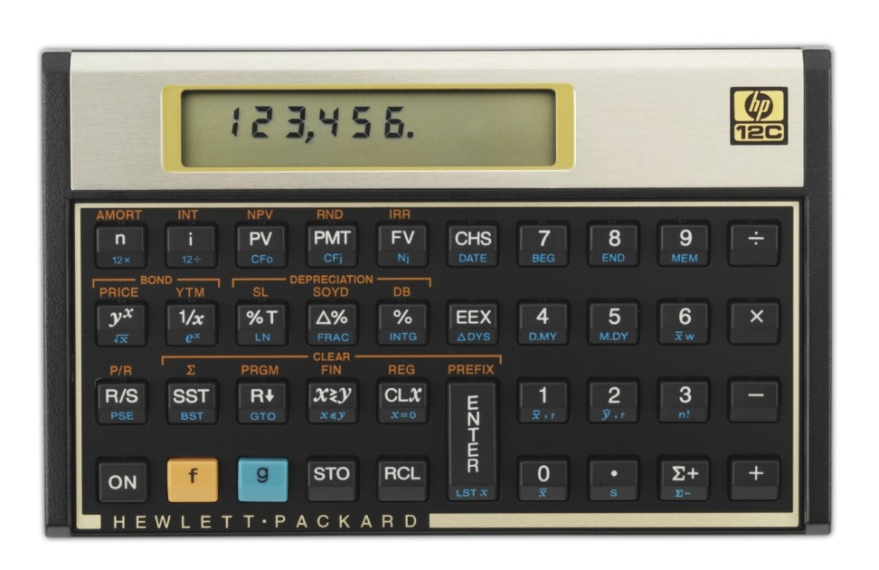
Financial Calculator
Financial calculators have built-in functions that save time in solving time value of money problems, and their use is permitted in examinations. We will also work on examples in lectures.
It is suggested that you procure a financial calculator and become proficient in using its time value of money functions. You should refer to the user manual for instructions.
Financial calculator: recommended models – TI BA II Plus or HP 12C
NOTE: Programmable calculators and calculators with text display functions are NOT allowed during examinations. All HKEAA approved calculators are allowed during examinations.

Slide 10


Textbook
There are two suggested textbooks:
Fabozzi/Modigliani/Jones
Mishkin/Eakins
Both are available in the library and the bookstore
Neither are required, and the course does not strictly
follow either
However the textbooks may be useful for your own
study, for example end of chapter questions

Slide 11
How to study for this class
All parts of the grade count: prepare all assignments on time
Attend all classes, and review the video if you have missed it. Not everything is on the slides!
Review the slides and your notes carefully before the exams
PRS questions and quizzes are designed to help you prepare for the exams, which will follow a similar format (MCQ and T/F). Review those carefully before the exams.
Ask questions if you don’t understand! Raise your hand in class. Catch me or Benson after class, make an appointment, email….
Participate

Slide 12
Course Map
Overview
If time allows
Foundations of
Interest Rates
Financial Institutions
Pricing of Financial Assets
Regulations
DCF
Sell Side
Buy Side
Stock
Valuation
Banking Regulation
Basics of
Interest Rates
Commercial Banking
Traditional Institutional Investors
Monetary Policy
Investment Banking
Alternative Investors
12

Slide 13
Course Tentative Agenda First Half: Overview, Rates, Financial Intermediation, Sell-side
Week 1,2(Feb 4,7,11,14) : Introduction; overview of financial markets
End of Add/Drop period: 17 Feb
Group formed due: 17 Feb
Week 2, 3(Feb 18, 21) : Discounted Cash Flows and Interest Rates basics (Part I), (part II)
Week 3, 4 (Feb 25,28 Mar 4): Financial intermediation; types of Fis
Group Submissions due (28 Feb)
Online Quiz I (29 Feb)
Week 5 (Mar 7, 11): The sell-side: commercial banks
Week 6 (Mar 14, 18): The sell-side: investment banking
Online Quiz II (Mar 22)
Mid-term Exam(Mar 25)

Slide 14
Course Tentative Agenda Second Half: Buy-side, Pricing Basics, Regulation, Monetary Policy
Week 7 (Mar 21): Fundamentals of pricing : stock valuation and asset pricing basics
Week 8 (Mar 28, Apr 1) : The buy-side: insurance
Week 9 (Apr 4,8 ) : The buy-side: pensions and retirement
Online Quiz III (Apr 12)
Week 10 (Apr 11, Apr 22) : The buy-side: asset management
Week 11 (Apr 25,29): The buy-side: alternatives
Week 12,13 ( May 2, 6, 9) : Central banking & monetary policy, bank regulation
Online Quiz IV (May 10)
Final Exam Period: Exam II

Slide 15

Copyright Issues
The lectures will be recorded by UST
Videos will be made available on CANVAS and are subject to copyright; students are not allowed to copy, duplicate or disseminate the videos without prior written consent
No other recording or taping is allowed
The lectures notes are provided to you for single use. You may not copy or distribute all or any part of the notes without the written consent of the Lecturer.
Please be aware of intellectual property issues in all your work and presentations. Take care to indicate the source of your quotes and include a reference list at the end of your presentations.
Plagiarism is not tolerated at HKUST. Plagiarism software may be used in evaluating homework and clear cases of plagiarism will impact your grade significantly.

Slide 16
Contact Info
Instructor: Prof. Veronique Lafon-Vinais
Email HKUST: vlafon@ust.hk
Telephone: office: 2358-7686 (please do NOT leave voice mail)
Mail to: Department of Finance, HKUST
Meeting by appointment only
TA: Benson Leung
E-mail: bbsleung@ust.hk
Meeting by appointment only
Notes:
My office on campus is in room 2445 (2 floor, close to lifts 25/26). If you need to contact me, the best way is by email, as I will be checking my email account daily. If you need to see me, I will generally be available after class, or you can make an appointment to see me (to avoid disappointment).
In case of emergency only, you can call me on my mobile.
For practical and UST related questions, please contact the MBA office or the Department of Finance staff.
Teaching Assistant: Mr. Siming TIAN Email: simingtian@ust.hk; Room 3392 (Lifts 17-18) Phone: 2358 7689
Office Hours: Tue 10:00-12:00, Wed 10:00-11:00 and by appointment
Mail: address to Department of Finance at HKUST, clearly indicating course reference and instructor’s name.

Slide 17

Ask Questions
Definitions, terminology & jargon
Never take anything for granted
Nothing new under the sun
No stupid questions
No one has all the answers …not even me!
Notes:
Some terminology index will be provided.

Slide 18
Course Map
Overview
If time allows
Foundations of
Interest Rates
Financial Institutions
Pricing of Financial Assets
Regulations
DCF
Sell Side
Buy Side
Stock
Valuation
Banking Regulation
Basics of
Interest Rates
Commercial Banking
Traditional Institutional Investors
Monetary Policy
Investment Banking
Alternative Investors
18

Slide 19
Course Map
Overview
The Language of Business
What is finance? Why do we need a financial system?
Who are the players?
How does it work?

Slide 20
Quick reminder on types of firms
When setting up a business, you have to decide which type of legal structure to use
There are many different types of legal structures ranging from sole proprietorship to listed limited liabilities corporations.
The choices available to you depend on the country of incorporation’s legal system.
For example, Hong Kong’s legal system is based on English law and is quite different from the US which has both federal law and different state laws
New York law is different from Delaware law, for example
The firm and its structure

Slide 21
Some examples of corporate organization in the financial industry
Mutual funds: mutual organization: the investors are also the shareholders (in a mutual organization, customers are the shareholders)
Banks: typically listed corporations (limited liability companies) but some are cooperatives or credit unions ( a form of mutual organization)
Insurance: can be limited liability companies or mutual organizations
Hedge Funds and Private Equity Funds: limited partnerships, with General Partners and Limited Partners
In the economy there are all forms of organizations, including many sole proprietorships, but the organizations we discuss in class are mainly limited liability companies (generally publicly listed)

Slide 22
The corporation
In business and finance classes, we generally focus on publicly listed corporations, which are limited liability companies.
A corporation is a legal entity in its own right. It has rights and obligations under the relevant legal system.
In such entities, the owners are the shareholders, but their liability is limited to the amount they have invested to buy the shares.
The corporation has a governance structure, whereby the shareholders appoint a board of directors to represent their interests, and the board appoints a management team headed by a CEO.

Slide 23
Why does it matter?
The choice of legal structure has important implications:
Risk for the different parties
Tax
Conflicts of interest
Possibility to raise capital
Survival of business

Slide 24
Pop Quiz!
What makes mutual organizations different?
If my friend and I are lawyers and we want to set up our own law firm, what legal structure should we use?
If you are a shareholder in a publicly listed corporation, are you responsible for the debt of the company?

Slide 25
Financial Statements
Financial statements are accounting reports issued periodically to present past performance and a snapshot of the firm’s assets and the financing of those assets
Regulations generally require publicly listed companies to file their annual financial statements with listing authorities; they must send an annual report together with their financial statements to their shareholders. The annual report is a yearly summary of the business. It must generally be verified by an auditor.
Example: CX annual report https://www.cathaypacific.com/content/dam/cx/about-us/investor-relations/interim-annual-reports/en/annual_report_2019_eng.pdf
Investors, financial analysts, managers, and other interested parties such as creditors rely on financial statements to obtain reliable information about a corporation
Financial Statements
Copyright ©2015 Pearson Education, Inc. All rights reserved.

Slide 26
Accounting standards
Accounting standards provide the “language” of financial statements.
There are different types of standards, like there are many languages – in the old days, each country had its own set of Generally Accepted Accounting Principles “GAAP”.
Two main global standards nowadays, which are broadly converging:
IFRS (International Financial Reporting Standards) which are increasingly adopted worldwide (currently > 100 countries)
US GAAP in the US only, but companies who want to issue securities in the US market have to convert their statements to US GAAP (unless they use IFRS)

Slide 27
Quick Search!
Find out which accounting standards are used in your country

Slide 28
Role of the auditor
Financial statements generally must be reviewed and certified by an auditor.
The auditor must check that the financial statements present a true picture of the financial health of the company, and must sign off on the statements by providing a statement to the shareholders
Problem: conflicts of interest.

Slide 29
Pop Quiz!
Why do firms have to publish financial reports?
Why does it matter that there are different accounting standards?
What is the role of auditors?

Slide 30
Types of Financial Statements
The main types of financial statements are:
Balance sheet (statement of financial position)
Income statement (profits and loss account)
Cash flow statement
Statement of changes in shareholders equity
Financial Statements
Copyright ©2015 Pearson Education, Inc. All rights reserved.

Slide 31
The Balance Sheet
Also called “Statement of Financial Position”
Lists the firm’s assets and liabilities, as well as shareholders’ equity
Provides a snapshot of the firm’s financial position at a given point in time
In simple terms, a balance sheet presents a picture of what the firm OWNS (assets) and OWES (liabilities) at a specific point of time.
Financial Statements
Copyright ©2015 Pearson Education, Inc. All rights reserved.

Slide 32
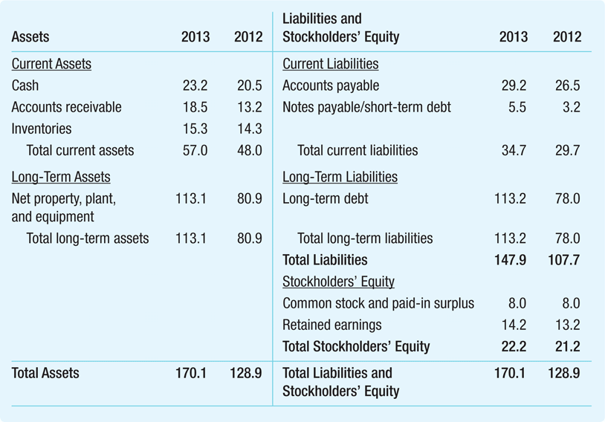
Illustration: Global Corporation Balance Sheet for 2012 and 2013
ASSETS
LIABILITIES
Uses of Capital
-
What we OWN
Sources of Capital –
What we OWE
The difference between assets and liabilities is the shareholders’ equity
The firm’s net worth
Financial Statements
Copyright ©2015 Pearson Education, Inc. All rights reserved.

Slide 33
The Balance Sheet
The Balance Sheet Identity
The two sides of the balance sheet must balance
If we OWE more than we OWN we have negative equity
It should not be possible and is generally not desirable but we will see that the book value and the market value may be different, allowing successful firms to borrow more than the book value of their assets
Financial Statements
Copyright ©2015 Pearson Education, Inc. All rights reserved.

Slide 34
Shareholder’s Equity (Capital)
Shareholders’ (Stockholders’) Equity
The difference between Assets and Liabilities constitutes the shareholders’ equity – also called book value of equity
An accounting measure of the net worth of the firm
Main components:
Share (equity) capital (money invested directly by shareholders in exchange for shares of the company)
Retained earnings (reinvestment of profits)
Financial Statements

Slide 35
Market v. Book Value
Market Value v. Book Value
Book value of equity
Net worth from an accounting perspective
Assets – Liabilities = Equity
True value of assets may be different from book value because (i) the true value of an asset may be different from its book value and (ii) many valuable assets are not captured on the balance sheet: ex: reputation, quality….
Market capitalization (also called market value of equity)
Market price per share times number of shares
Does not depend on historical cost of assets
Financial Statements
Copyright ©2015 Pearson Education, Inc. All rights reserved.

Slide 36
Quick Search!
Find out what is the book value (annual report 2019) and the market value (market cap) of Cathay Pacific (today)
Notes:
Equity: Total equity HKD 62,776 million USD 8,048 million annual report page 72 https://www.cathaypacific.com/content/dam/cx/about-us/investor-relations/interim-annual-reports/en/annual_report_2019_eng.pdf
Market cap: number of shares: 3,933,844,572 (https://www.cathaypacific.com/cx/en_HK/about-us/investor-relations/stock-information.html) price: 6.16 https://www.bloomberg.com/quote/293:HK?sref=INmNRPZ9

Slide 37
Funding the business
Funds come from 2 main sources (as evidenced by the balance sheet):
Equity (Capital) => shares/stocks
To start a business we source money from the 3Fs (friends, family & fools) by issuing shares (stock)
Later on, we can raise more money from financial investors (generally angel investors, venture capital, private equity)
As we become a larger business, we typically get listed (IPO) and raise money from the general public (retail investors)
Debt (Liabilities) => loans, bonds, notes, leases…
We can borrow money from : suppliers (payables & trade credit); banks (loans) finance companies (leases) and investors (bonds, notes, private placements)

Slide 38
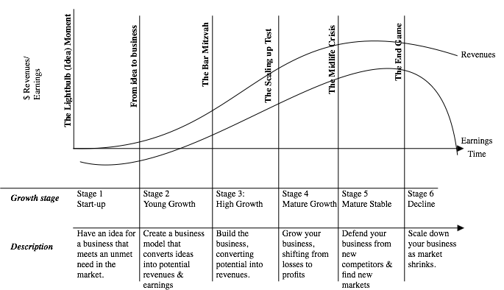
Life Cycle of Firms
Source: Prof. Damodaran, NYU Stern
Notes:
Source: Damodaran http://pages.stern.nyu.edu/~adamodar/New_Home_Page/cfpuzzles/cfspr16puzzle1.htm

Slide 39
Life cycle and funding
Firms
“Self” funding
Cash flow
Stage 1
“Inside” funding
Family & Friends
Stage 2
Firms
Information-intensive external funding
Banks & Financial Intermediation
Widely known firms access investors directly
Corporate bond markets
Firms
Stage 3
Notes:
Stage 1: building up savings from internally generated funds (self funding) and borrowing from close or distant relatives and friends (inside funding) where borrower is “bonded” by its close relationship which monitors its behaviour and enforce discipline
Stage 2: firms have grown such that self and inside funding is insufficient and need external funding. Banks provide information intensive external funding; the external finance premium includes cost of credit evaluation, loan monitorinng, component for risk of default and cost of managing default.
Stage 3: firms grow such that large external funding required (eg infrastructure); widely known firms can access funding directly from investors with corporate bond funding (eg railroad companies in 19th century used direct bond finance because they had a relatively transparent public image and a physical capital structure that was relatively easy to monitor). => firms with good public image which produce a product that is widely used and easily monitored, have an incentive to bypass bank loans in order to exploit their transparency to lower their external finance premium
Firms with access to bond markets also continue to use bank financing because banks provide other services:
backstop financing (LOC, SBLC)
debtor-in-possession financing in event of bankruptcy
Customised borrowing
Confidential borrowing
By encouraging innovation, competition among banks and non-bank financial markets helps to improve the distribution of financial risk in the economy and lower the cost of external finance.
The growth of non-bank finance also improves the resilience of the financial system => “spare-tyre” role of capital markets in cushioning the effect of financial distress on the macroeconomy.
Long term, local currency corporate bonds can also efficiently hedge real future retirementm pension, life insurance and entitlement commitments.
Source: Marvin Goodfriend, Carnegie Mellon University “Why a corporate bond market: growth and direct finance” BIS Papers No 26, BIS conference on Developing Corporate Bond Markets in Asia, Nov 2005

Slide 40
The Income Statement
The income statement lists the firm’s revenues and expenses over a period of time
Sometimes called the profit and loss statement, or “P&L”
The last or “bottom” line of the income statement shows net income (also called “profits” or “earnings”)
A measure of its profitability during the period
Also referred to as the firm’s earnings
In simple terms, the income statements shows what the company earns and how profitable it is!
Financial Statements
Copyright ©2015 Pearson Education, Inc. All rights reserved.

Slide 41
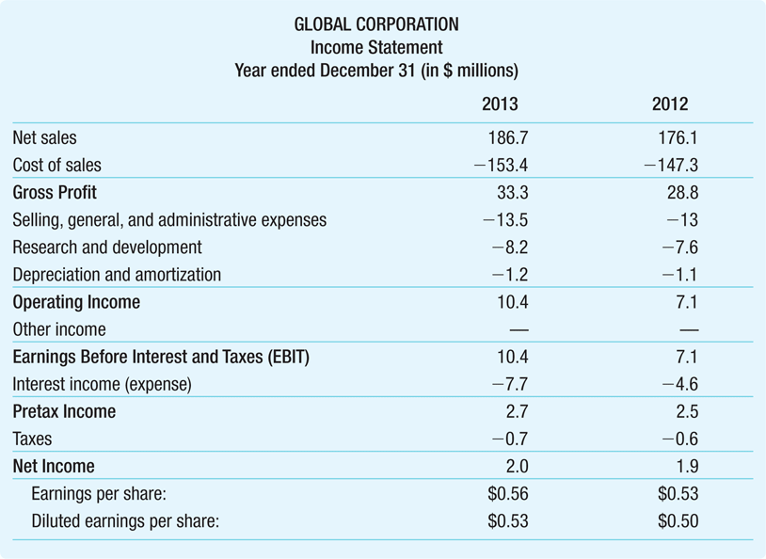
Illustration: Global Corporation’s Income Statement Sheet for 2013 and 2012
Profit & Loss Account
Revenues
Cost of Goods Sold
S, G & A
Operating Expenses
R & D
Net Profit, Earnings
EPS
Financial Statements
Copyright ©2015 Pearson Education, Inc. All rights reserved.

Slide 42

The Statement of Cash Flows
The firm’s statement of cash flows uses the information from the income statement and balance sheet to determine:
How much cash the firm has generated
How that cash has been allocated during a set period
Cash is important because it is needed to pay bills and maintain operations and is the source of any return of investment for investors
Financial Statements
Copyright ©2015 Pearson Education, Inc. All rights reserved.

Slide 43
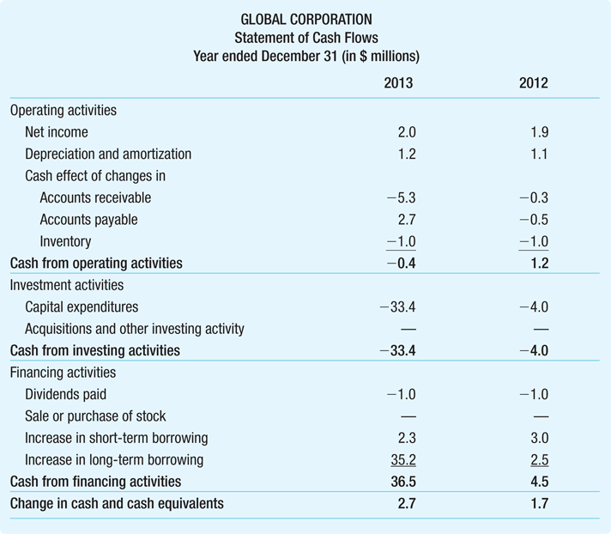
Illustration Global Corporation’s Statement of Cash Flows for 2013 and 2012
The statement of cash flows is divided into three sections which roughly correspond to the three major jobs of the financial manager: Operating activities Investment activities
Financing activities
Financial Statements
Copyright ©2015 Pearson Education, Inc. All rights reserved.

Slide 44
Pop Quiz!
When a start-up raises equity capital from investors, does it issue shares or bonds?
When a company needs to finance a new project with debt, will it issue shares or bonds?
If a company is losing money, are its earnings positive or negative?
As a retail investor, how can you invest in a company to make money from its growth?

Slide 45
Some important ratios and terms you should know about
EBIT and EBITDA
EPS

Slide 46
EBITDA
EBITDA
Financial analysts often compute a firm’s earnings before interest, taxes, depreciation, and amortization, or EBITDA
Because depreciation and amortization are not cash flows (non-cash expense), this subtotal reflects the cash a firm has earned from operations
This is a measure frequently used in debt covenants
Financial Statements
Copyright ©2015 Pearson Education, Inc. All rights reserved.

Slide 47
EPS
Earnings Per Share EPS
Net income reported on a per-share basis
EPS = Net Income
Shares Outstanding
Financial Statements
Copyright ©2015 Pearson Education, Inc. All rights reserved.

Slide 48
Quick Search!
Find out Cathay Pacific’s EPS as of 2019
Notes:
https://www.bloomberg.com/quote/293:HK?sref=INmNRPZ9
Negative EPS…

Slide 49
Course Map
Overview
The Language of Business
What is finance? Why do we need a financial system?
Who are the players?
How does it work?

Slide 50

Imagine…
A region without money…
A country with no banking system…
A world with no global capital flows…
Why was Muhammad Yunus the 2006 Nobel Peace Prize winner?

Slide 51
Evolution of Financial System
Securitization
Corporate
Bond
Markets
Equity
Finance
Exclusive
Reliance
on Bank
Finance
Notes:
Financial markets (systems) evolve over time, accompanying the development of the economy, in a progression beginning with exclusive reliance on bank finance, moving gradually towards equity finance, then corporate bond markets, and ultimately to securitization
The whole structure of the financial system, from the banking sector to securities markets, together with its link to the international financial markets through the capital and financial account, must be adjusted to the stage of development of the economy.
The linear evolution of the financial system from bank-based to market-based in a domestic context must be complemented by a second, international dimension, along the process of integration of the domestic financial markets in the global financial markets. Ultimately, the desired outcome is one of full financial liberalisation.
Integration into the global economy brings obvious benefits, but also poses risks.

Slide 52

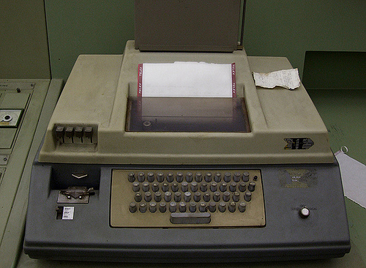
Tech, tech, FinTech
When I started working, this is the technology we had:
Mainframe computer
Telephone
Telex
Typewriter
Post

Slide 53
Quick Search!
What is a telex?
Notes:
https://en.wikipedia.org/wiki/Telex#:~:text=Telex%20was%20a%20major%20method,in%20popularity%20in%20the%201980s.
https://www.youtube.com/watch?v=byMwNPj47X8

Slide 54
Disruptive Technologies
The next big thing?
Mobile Internet
IoT
PC
Internet
Computer
Fax
Typewriter
Telex
Telegraph
Telephone
Recent developments: artificial intelligence (AI), Big Data……
Post
Fall 08
Notes:
54

Slide 55
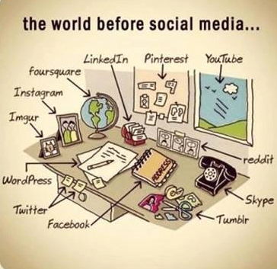
Notes:
Source: Twitter https://twitter.com/FactsGuide/status/593663669235482624

Slide 56

Class discussion
What do we need for financial markets to exist and function properly?

Slide 57
Financial Markets
Media & PR
Corporations
Commercial
Banks
Brokers
Service
Providers
Institutionals
Investment
Banks
Information
Providers
Public
Exchanges
Regulators
Notes:
57
Participants in the corporate finance industry include:
Ultimate clients: (in green) corporations, institutionals, public; they can be issuers, sellers, buyers…
Regulators and exchanges (in blue)
Financial Intermediaries (in pink): commercial and investments banks and brokers and other FSPs
In yellow: various service providers including:
Information providers : Bloomberg, Reuters, Thomson and others
Media and PR: CNN, CNBC, PR firms, roadshow organizers
Service Providers : Lawyers, Accountants, Auditors, Printers
The IP sell their services to pretty much all the other players (limited sales to Joe Public)
We concentrate on the 2 main bodies of financial intermediaries who are the main sales target for information providers such as Thomson.

Slide 58
Key building blocks for capital markets
Source McKinsey April 2017
Notes:
Source McKinsey April 2017 http://www.mckinsey.com/industries/financial-services/our-insights/deepening-capital-markets-in-emerging-economies?cid=other-eml-alt-mip-mck-oth-1704&hlkid=98808b4c6c284aa7b75c982fa702146b&hctky=2168735&hdpid=9657dc63-3be4-4ca0-9adc-7de54fcfb8a6
Patient reputation building
High performance standards
Resilient infrastructure
Robust regulatory framework = understanding the regulatory imperative
Leadership & Vision => setting clear objectives
Political commitment => actively developing the market:
Stimulate development of new asset classes
Encourage pension fund reform
Promote privatization
Obstacles
Volatile and inconsistent economic policy
Underdeveloped commercial law
Slow pace/absence of privatization
Lack of talent
Poor regulation
Inadequate pension systems
Inadequate market makers
Inadequate infrastructure

Slide 59
Functions of Financial Markets
Channeling funds
Efficiency
Price determination
Risk sharing
Liquidity
Financial stability
Information aggregation and coordination
Notes:
59
Channeling funds: financial markets permit the transfer of funds (purchasing power) from one agent to another for either investment or consumption purposes; Allow transfers of funds from person or business without investment opportunities to one who has them; Channel funds from savers (economic units with financial surplus and/or who don’t have a productive use for the funds) to investors (economic units with financial deficit and/or who do have a productive use for the funds), thereby promoting economic efficiency; Do not serve only for raising funds (cf FX and derivatives markets)
Efficiency: financial markets reduce transaction costs and information costs. Provide an efficient allocation of resources from savers to productive investors; Improve economic efficiency
Price determination: financial markets provide vehicles by which prices are set both for newly issued financial assets and for the existing stock of financial assets; Offer current and future price determination through bid/offer mechanism
Risk sharing: financial markets allow a transfer of risk from those who undertake investments to those who provide the funds for those investments. Dilute risk by spreading it across a large pool of economic agents
Liquidity: financial markets provide the holders of financial assets with a chance to resell or liquidate these assets
Reduce both probability and cost of systemic instability and financial crises
Information aggregation and coordination: financial markets act as collectors and aggregators of information about financial assets values and the flow of funds from lenders to borrowers;
Market structure:
Require active participation of a number of professionals (it takes at least three participants to create a market) who are free to make decisions (apart from resources/rules constraints); the exchange carried out through the market is voluntary and competition is usually present and adds to the autonomy
Generally share a common information system
Can work with no one in charge
Are a social construction which must be well built in order to work smoothly : the market design must be good, i.e. the mechanisms that organize buying and selling; the channels for the flows of information; the laws and regulations that define property rights and sustain contracting; and the markets culture, its self-regulating norms, codes and conventions regarding behavior. (source: John McMillan)
Function of financial markets as supplier of financial services to the public: the financial system can also be viewed as collection of financial service firms that produce, distribute and sell financial services to the public, including:
Payments services (payment accounts, checks, fund transfer & wire, cash/debit/payment/credit cards)
Thrift services (financial instruments with adequate safety and yield to encourage people to save)
Insurance services (providing protection from loss of income or property)
Credit services
Hedging services (providing protection against loss arising from market movements)
Agency services (acting as agent for customer in managing funds or other property)

Slide 60
Quick Search!
Find a map of Asia

Slide 61
Asia’s Financial Markets
No transaction efficiency
Information asymmetry
Affects price efficiency
Fragmented markets
Lack of information
Reliability of information
Timeliness and accuracy of information
Legal (un)certainty
Weak regulators
Notes:
61
Asia compared to Europe or the US is a heterogeneous market; some countries are developed, OECD countries with sophisticated financial systems; others are developing countries with rather primitive financial markets and archaic infrastructure. Payments systems are at times extremely basic (e.g. India) and at times highly sophisticated (Hong Kong). Information can be extremely difficult to obtain. (expand with map next slide)
The corporations run the gamut from highly sophisticated investment grade MNCs to local, family owned companies.
Generally speaking disclosure standards are very low, although improvements have been noted after the Asian crisis.
Quality of information varies dramatically depending on the countries and the corporations.
What does this mean for banks? =>
Local teams and regional headquarters => conference calls with HQ in US or Europe at midnight
Wide range of products
Strategic choice of target markets and target clients (eg super-core and core accounts)
Potential P&L versus expanded cost base.
Volatility
Political risk

Slide 62
McKinsey Asian Capital Markets Development Index
Source McKinsey April 2017
Notes:
Source McKinsey April 2017 http://www.mckinsey.com/industries/financial-services/our-insights/deepening-capital-markets-in-emerging-economies?cid=other-eml-alt-mip-mck-oth-1704&hlkid=98808b4c6c284aa7b75c982fa702146b&hctky=2168735&hdpid=9657dc63-3be4-4ca0-9adc-7de54fcfb8a6

Slide 63
Constituents of the McKinsey ACMD Index
Source McKinsey April 2017
Notes:
Source McKinsey April 2017 http://www.mckinsey.com/industries/financial-services/our-insights/deepening-capital-markets-in-emerging-economies?cid=other-eml-alt-mip-mck-oth-1704&hlkid=98808b4c6c284aa7b75c982fa702146b&hctky=2168735&hdpid=9657dc63-3be4-4ca0-9adc-7de54fcfb8a6

Slide 64
Pop Quiz!
When everything in a country is fully owned by the government, can there be an effective capital market?
Why is climate change a risk factor for capital markets?
What are some of the challenges investors face in frontier markets?

Slide 65
Course Map
Overview
The Language of Business
What is finance? Why do we need a financial system?
Who are the players?
How does it work?

Slide 66
The Players
Sources of funds (Investors)
Institutionals
Sovereigns and quasi-sovereigns
Banks & FIs
Corporations
HNWI
Public (households)
Users of funds (Issuers)
SSAs:
Supras
Sovereigns
Agencies
Banks
Corporations
SPVs
Notes:
66
Institutionals include:
Insurance companies (life and non-life) => life insurance cos have relatively assured C/F so can commit to take down up to several years forward and
Pension funds (private and public)
Mutual funds
Professional money managers invest on behalf of customers, owners or beneficiaries of financial institutions and private firms (hedge funds)
A Hedge Fund is a private investment partnership that takes leveraged positions in various segments of the capital markets.
Governments include state and local governments
Agencies is a term that describes agencies of the US government in the broad sense. It includes both agencies of the US that carry the full faith and credit of the US government and others.
HNWI = High Net Worth Individuals (important investor segment in the Eurobond markets)
Investors tend to be classified according to their investment strategies. For example, some investors are passive, tending to run indexed portfolios in which the investors portfolio is indexed to a broad index market e.g. Lehman’s fixed Income Index. Other investors follow active portfolio policies.
Supra = supranationals. A supranational is an institution formed by 2 or more central governments through international treaties. Example: World Bank, ADB
Captive finance companies of large corporations are active players in the markets as issuers and/or investors.

Slide 67
The Players
Warning! We will explain the difference between “intermediaries” and “financial intermediaries” later
Intermediaries
Investment bankers
Primary dealers/traders
Brokers
Credit and liquidity enhancers
Other actors
Regulators
Service providers
Rating agencies
Notes:
67
Investment Bankers:
Offer advice
Help prepare documentation
Agree pricing
Underwrite securities
Underwriters:
purchase bonds and resell them at an agreed mark-up
Provide a form of insurance by guaranteeing the price
Are middlemen who typically buy securities from the issuer and resell to the market
Sometimes actually don’t underwrite but just market the securities
Note that when Glass-Steagall Act was enforced (before it started to crumble in the 80s), commercial banks in the US were prohibited from underwriting securities.
Traders/Market Makers/Dealers:
“make” markets by offering to buy/sell bonds
Includes primary dealers for government securities
In the US, national and regional securities dealers maintain the OTC market.
Brokers: (also called interdealer brokers)
don’t take positions
Charge a fee/commission for putting parties together
Aggregate information about the bids and offers posted by various dealers and disseminate that information on computer screens without revealing the identity of the dealers. Dealers pay interedealer brokers commissions for their services.
Regulators:
In the US the securities industry is regulated at the national level by the SEC and NASD, and at the state level by local regulators
The US SEC is a Federal Agency that oversees the securities regulation in the US. The SEC:
Licenses brokers, broker-dealers, mutual funds managers
Administers registration of securities for public trading
Monitors Federal securities law compliance
Service Providers include:
Lawyers
Accountants
Auditors
Rating Agencies
Information Providers (Reuters, Bloomberg, Thomson Financial)
Printers
Media & PR

Slide 68
Class discussion
“Incentives are the cornerstone of modern life and understanding them - or, often, ferreting them out - is the key to solving just about any riddle, from violent crime to sports cheating to online dating.”
Steven Levitt/Stephen Dubner, Freakonomics
What are the objectives and incentives of each of the
categories of players in the markets?
Notes:
68
An incentive is simply a means of urging people to do more of a good thing and less of a bad thing. There are 3 basic flavors of incentives: economic, social and moral. Very often a single incentive scheme will include all three varieties.
Issuers:
To sell securities at a fair price
To have orderly and liquid secondary market in their securities
To be able to reverse and modify earlier issuance decisions in response to market conditions efficiently
To design and issue debts securities that best suit their requirements
Investors:
To buy securities of different risk-return profiles at a fair price
To obtain diversification at a low cost
To reverse previous decisions at a low cost
To have access to risk management services
To get information at a low cost
Intermediaries:
To provide primary market making services such as bidding in the auction, underwriting, and distribution
To provide orderly market making in the secondary market
To provide risk management and asset liability management services
To provide prop trading activities

Slide 69
Course Map
Overview
The Language of Business
What is finance? Why do we need a financial system?
Who are the players?
How does it work?

Slide 70
Classification of Financial Markets
Primary v. Secondary
Debt v. Equity
Exchanges v. OTC
Domestic v. International
Public v. Private
……
Notes:
70
There are many types of classification of financial markets: the most common ones are:
By sequence (primary v. secondary)
By type of claim (debt v. equity)
By localisation of issuer (internal v. external)
By process & location of players (exchange v. OTC)
By maturity of the instruments (money market v. capital markets)
Here are some of the most common classifications of financial markets, but there are others.
Q to Ss: any ideas? A: Example: public and private markets – public being a market where products are sold to the general public, e.g. public debt capital market. Generally in public markets the securities are registered with the regulator; cash v. derivatives).
All the markets do not necessarily fit in all of the classifications, for example the loan markets is not considered part of the Capital Markets but is still a very large component of debt markets.
The interbank market is generally considered by the players in the market as part of the money markets but most books (specially academic books) don’t take them into account. In fact much of academia tends to concentrate rather exclusively on the securities markets, which actually only represent a very small fraction (albeit the most visible) of the ways of raising finance.
Money & Capital Markets:
Q to SS: anyone knows the difference?
A: classification a/c to maturity
Money Markets < 1 year
Capital Markets > 1 year
Sometimes MM is included in DCM (debt capital markets (cf intro Choudry)), generally if MM is defined as excluding the interbank market.
Cash v. Derivatives Markets:
Q to Ss: can anyone think of some examples?
cash market in FX is FX rate; derivatives in FX is forward market;
in equity market cash market is trading shares; derivatives markets is the futures and options markets;
in MM the cash market is the short term debt instruments like CP and CDs, the derivatives market is LIBOR forwards and futures)
ECB Classification of financial markets
Interest Rate
Equity
Foreign Exchange
Investment and Money Market Funds shares/units
Other Financial Markets

Slide 71
Primary & Secondary Markets
Primary market = raising money/capital for the first time
Secondary market = selling securities onto another investor
Notes:
71
The primary market is where companies raise money (known as capital) by issuing shares or bonds, Companies often raise capital via an IPO, In a similar way, the government raises money in the primary market by offering its gilts (government bonds) to investors, commonly by auction.
The key reason that investors are willing to buy securities in the primary market is that they know that they will be easy to sell on later in what is known as the secondary market. Without an active or liquid secondary market investors would be reluctant to invest. Illiquid securities are securities that are difficult to sell quickly and are therefore less attractive investments.

Slide 72
Primary v. Secondary Markets
Primary Market
Investor
A
Borrower/
Issuer
Secondary
Market
Investor
B
Financial
Market
Notes:
72
Primary & secondary markets:
Q to Ss: anyone can give me a definition?
A: classification a/c to sequence (go to Chart 1)
Primary: New security issues sold to initial buyers
Secondary: Securities previously issued are bought and sold
This distinction applies to both debt and equity markets as well as loan markets.
Primary markets: where issuers initially sell securities
Secondary markets : after debt or equity securities have been initially sold, they are traded in the secondary market.
The secondary markets can be auction markets (exchanges) or dealer markets (OTC).
Primary Markets
markets for issue of new securities to raise money for consumption or investment purposes
Include issue of both primary and indirect securities
Markets in non-negotiable instruments are entirely primary markets
Secondary Markets
Markets in which previously issued financial claims are traded
Differ in terms of breadth/depth/liquidity
Important
Functions of secondary markets:
Assist primary markets by providing investors with reversibility/marketability/liquidity
Provides the basis for price determination on new issues
Registers market conditions rapidly
Enables investors to adjust portfolios (size, risk, return, liquidity and maturity)
Enables central bank to influence liquidity in financial markets through open-market operations

Slide 73

Test Your Understanding/PRS time!
Is an IPO (initial public offering) a primary market or secondary market transaction?
Primary
Secondary
If you buy shares from another investor, is it primary market or secondary market transaction?
Primary
Secondary

Slide 74
Debt v. Equity
Debt
Legally binding obligation
No voting rights
Requires repayment of principal and interest
Interest is tax-deductible (some countries inc. US, but not always)
Covenants can be restrictive
Equity
Ownership
Voting rights on common stock
Dividends on common stock are optional
Dividends are paid from after-tax profits
All cumulative preferred dividends must be paid before dividends paid on common stock
The conditions in the contract
Notes:
74
A: Equities represent ownership shares in a business firm and as such are claims against the firm’s profits and against proceeds from the sale of its assets (P. Rose, Money & Capital Markets Ch2). Holders of equity shares are called shareholders or stockholders. Shareholder equity represents the difference between the value of the assets and the debt (liabilities) of the firm. In this sense it is a residual claim on the firm’s assets. The stockholders ‘ claim on the firm’s value at the end of the period is the amount that remains after the debt holders are paid (R/W/J Ch 1) Equity securities represent non contractual claims to the residual cash flow of the firm (R/W/J Ch 1). The Equities are generally subdivided into common stock (which entitles the holder to vote for the members of a firm’s board of directors and therefore determine company policy) and preferred stock (which normally carries no voting privileges but does entitle the holder to a fixed share of the firm’s net earnings ahead of its common stockholders). From the “set-of-contract” perspective (R/W/J ch1) the equity contract can be defined as a principal-agent relationship. The members of the management team are the agents, and the equity investors (shareholders) are the principals. It is assumed that the managers and the shareholders, if left alone, will each attempt to act in his/her own self interest (we will talk more about this principal agent problem a bit later under Asymmetric Information).
Debt entitles the debt holder (creditor) to a priority claim over the holders of equities to the assets and income of an individual, business firm, or unit of government. Usually that claim is fixed in amount and in time (not always: eg, perpetuals) and may be backed up by pledges of specific assets as collateral. (P. Rose, Money & Capital Markets Ch2). Debt securities are contractual obligations to repay corporate borrowing (R/W/J Ch2)
Debt and equities are financial assets, e.g. claims against the income or wealth of a business firm, household, or unit, of government usually represented by a certificate, receipt or other legal document.

Slide 75
Securities & Capital Markets
Securities = negotiable, tradable financial instruments
Include equity securities (stocks/shares) and debt securities (bonds/notes)
Capital markets = markets where securities are traded and where firms can raise capital (either equity capital or debt capital)
Include Equity Capital Markets (ECM) and Debt Capital Markets (DCM)
Financial markets include but are not limited to, capital markets. For example:
Foreign Exchange (FX) market (market for trading currencies) – the largest and most liquid of all financial markets, is not a “capital market” since participants don’t raise capital
Commodities market
Loan market
Money market (interbank, commercial paper, CDs…)
Derivatives market

Slide 76
Debt v. Equity Markets
Debt Markets
Equity Markets
DCM
Money
Markets
Loan
Markets
Hybrids
Notes:
76
Money Markets are short term debt markets I.e. instruments have a maturity of less than one year
Loan markets include all forms of bank loans including SAS, project finance, structured trade finance as well as trade finance for the purpose of this presentation (strictly speaking trade finance transactions are not loans)

Slide 77
Test Your Understanding/PRS time!
If a company issues bonds, which type of market does it use?
ECM
DCM
The FX market is a
Capital market
Financial market

Slide 78
Market Organization
4 main types of market organization:
Direct search
Brokered market
Dealer market
Auction market
Notes:
The market organization is the institutional arrangement by which buyers of securities are matched with sellers thereof. Form of market organization has significant impact on resulting price processes and bid-offer spreads
Properties of market organization:
Transparency => a well functioning market should be transparent. Transparency is the extent to which info about trades, quotes and other market info e.g. volume of trading and open interest are available to all players in the market.
Adverse selection
Lemons & plums problem
The intermediaries charge a wider bid-offer spread to all participants in the market when availability of info is not symmetric and the cost of obtaining additional info significant
Can be a significant factor in determining the bid-offer spread
Intermediaries routinely take large positions in securities and absorb the risk of price fluctuation before inventories are sold to customers
Risk of security in the market + ability to offload that risk in other markets + uncertainty in the cost of financing such inventories all contribute to the bid-offer spread determination and to the depth of the markets.
Informational disclosure requirements, regulatory rules and effectiveness of their enforcement affect price processes and bid-offer spreads
Exchanges & OTC:
Question to Students: What do you think this is?
Classification a/c to process and location of players
Exchanges (e.g., New York Stock Exchange): Trades conducted in central locations
OTC : Dealers at different locations buy and sell directly to each other
Question to Students: Give examples of OTC markets? Of Exchange markets?
Direct search => Buyers directly search and identify matching sellers without the benefit of one or more intermediaries, Costs of search, location and negotiation are borne by the individual transactor. Direct search typically applies in small markets with few buyers and sellers. The frequency of transactions must be so low that no intermediary would find it economical to provide any service.
Brokered market => Brokers act as agent to buyer and seller. They intermediate (for a fee) and match buyers and sellers at mutually agreed terms. Trading volume in securities must be heavy and there must be significant economies of scale in the search costs to locate counterparties, so that a direct search is a more costly alternative to buyers and sellers

Slide 79
Methods of Price Determination
Dealer markets: Price determined by market makers (traders/dealers) based on supply/demand; their existing position; their view of the market
Broker markets: Price determined by supply/demand
Auction markets: All bids and offers entered into system; price determined at equilibrium point (Dutch auction) or highest price bid
Some exchanges are auction markets while others are dealer markets

Slide 80
Exchanges vs. Over-the-Counter (OTC)
Exchanges
Over-the-counter (OTC)
One centralized “location”
2 types: stock exchanges and derivatives exchanges
Can be auction markets or dealer markets
Not localized
Dealer markets
Examples: bond market
Notes:
The Nasdaq vs. The NYSE
(Source: http://i.investopedia.com/inv/pdf/tutorials/electronic_trading.pdf )
From a glance, the difference between the New York Stock Exchange (NYSE) and Nasdaq may not be marked. The NYSE lists household names like Coca-Cola, Wal-Mart, Citicorp, and General Electric, whereas the Nasdaq is home to many of the tech giants such as Microsoft, Cisco, Intel, Oracle and Sun Microsystems. Besides the heavy tech weighting, the fundamental difference between the two exchanges is in the way securities are traded.
NYSE
The NYSE is an auction market that uses floor traders to make most of its trades. Each stock on the NYSE has a specialist; this is a person who oversees and facilitates all of the trades for a particular stock. If you wish to buy a stock that trades on the NYSE, your broker will either call your order to a floor broker, or enter it into the DOT system (which we will discuss later on).
Nasdaq
The Nasdaq, on the other hand, is not a physical entity. The Nasdaq might be known for its fancy MarketSite Tower and broadcast studio in Times Square, but very little is done there. The Nasdaq is an over-the-counter (OTC) market and it relies on market makers rather than specialists to facilitate trading and liquidity in stocks. For each stock, there is at least one market maker, (large stocks such as Microsoft have several), whose duties we will discuss later on. Rather than being an auction market, the Nasdaq is a communications network between thousands of computers. Instead of brokers calling out orders, market makers place their names on a list of buyers and sellers, which is then distributed by the Nasdaq in a split second to thousands of other computers. If you wish to buy a stock that trades on the Nasdaq, your broker will either call up a market maker with the information of your trade or enter your order into a Nasdaq-sponsored online execution system

Slide 81

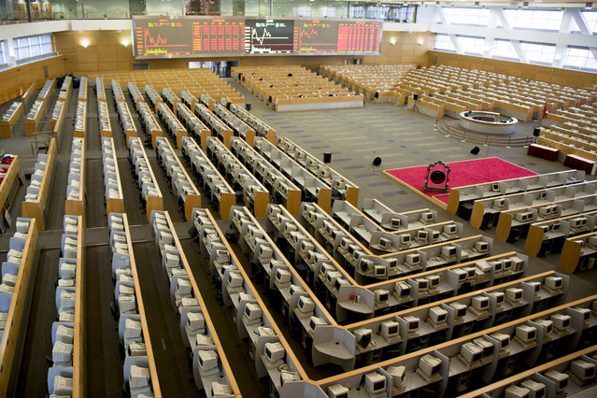

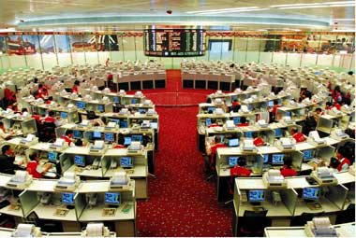
Game: Identify these Asian securities exchanges
3
1
2
4
Notes:
Shanghai Stock Exchange
HKEx (HK Stock exchange)
SGX (Singapore Stock Exchange (before floor trading stopped)
Tokyo stock exchange

Slide 82
Some misunderstandings
Trading v. listing: financial instruments can be listed on an exchange …
to list a security or a financial instrument on an exchange, the firm needs to meet the listing requirements and rules of that particular exchange
… But don’t necessarily trade on that exchange
Trading has to do with supply and demand for that particular instrument
A stock can be listed on an exchange but very rarely trade on it if there is no or limited liquidity
Some financial instruments ONLY trade on exchanges
for example futures are exchange specific financial instruments
Others can be traded on exchanges or OTC
for example bonds are often listed on exchanges but generally trade OTC.
Spot FX only trades OTC

Slide 83
Current issues related to market organization
The advent of electronic trading
Will open outcry disappear?
Demutualization and listing of exchanges
Mergers and consolidation
Dark pools and private exchanges
Advent of High Frequency Trading (HFT)
Regulators push to move OTC onto exchanges
Impact?
Notes:
As recently as December 2005, the floor was home to 1,244 equity members — specialists, now called “designated market makers,” and brokers — and 2,087 clerks, according to the exchange. Today there are 442 equity members and 627 clerks. The number of independents has fallen to fewer than a dozen from 50 or more two decades ago. The floor is a victim of technology. Electronic exchanges such as longtime rival Nasdaq Stock Market and recent upstart BATS Exchange have siphoned off much of the activity from the floor by creating ultrafast trading networks. The NYSE responded to the pressure in 2006 by acquiring an electronic exchange of its own, Archipelago Holdings; the following year it snapped up Euronext, the multinational European exchange that had itself gone largely electronic, to create holding company NYSE Euronext. Now, of the roughly 6.5 billion shares of U.S.-listed stocks that change hands each day, the NYSE handles only about a third of the total, according to industry estimates. Even for NYSE-listed stocks, the exchange has a market share of just 42 percent, according to its most recent statistics. A substantial percentage of the volume that does make it to the floor, moreover, is executed via a single click on NYSE Arca without the need for two human beings — a floor broker and a specialist — to interact. Floor brokers accounted for just 5 percent of overall volume in April, exchange data show. Source: NYSE technology threatens survival of floor traders, II 06 July09

Slide 84
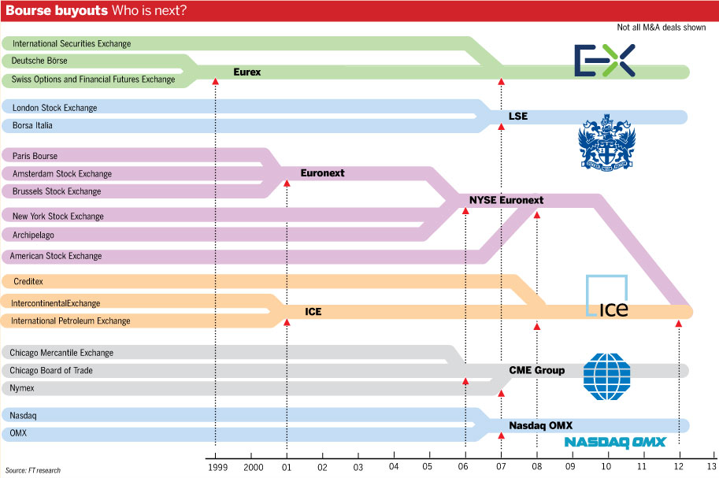
Source: FT“ICE and NYSE Euronext go where other exchanges have struggled” 3 October 2013
Notes:
Source: FT“ICE and NYSE Euronext go where other exchanges have struggled” 3 October 2013
http://www.ft.com/intl/cms/s/0/c6c899fc-2b56-11e3-bfe2-00144feab7de.html?ftcamp=crm/email/2013104/nbe/GlobalBusiness/product#axzz2hC887RHW

Slide 85
Test Your Understanding
Futures are traded on
Exchange markets
OTC markets
FX is traded on
Exchange markets
OTC markets

Slide 86
Domestic, Euro and Foreign markets
To determine if a securities issue is domestic, foreign or “Euro” we need to check three key variables:
what currency is the security issued in?
Where is the security placed? (where are the investors)
Where is the issuer?
Domestic issues: placed with investors in the country of the currency and the issuer is also from the country of the currency
Example: HK Land issues a HKD bond placed to HK investors

Slide 87
Domestic, Euro and Foreign markets
Foreign issues: placed with investors in the country of the currency but the issuer is from a different country
Example: HK Land issues USD bond to US investors
“Euro” issues: placed with investors outside the country of the currency. It doesn’t matter where the issuer is from.
WARNING!! Very confusing as “Euro” here is NOT the Euro currency. “Euro” here means the currency is used OUTSIDE its country.
Example 1: HK Land issues a EUR denominated bond to HK investors
Example 2: HK Land issues a USD denominated bond to EU investors

Slide 88
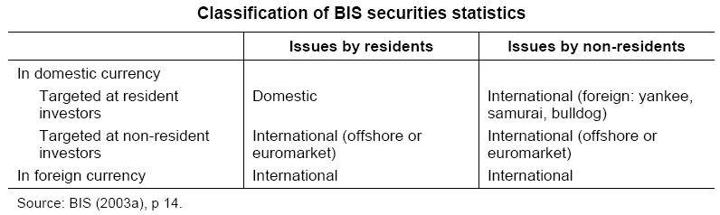
BIS Classification of Bond Markets
For the BIS, securities issues are classified as domestic or international. The international category includes foreign and “euro” issues.
Notes:
88
Source: http://www.bis.org/publ/bppdf/bispap30d.pdf
Bond markets can be classified according to residence of issuer, targeted investors and currency of denomination. For instance, the BIS international securities data cover everything but issues by residents targeted at resident investors denominated in domestic currency (Table 1). Issues by non-residents targeted at resident investors and denominated in domestic currency are part of the foreign bond markets, which go by various colourful names (yankee for United States; samurai for Japan; bulldog for the United Kingdom). Offshore (or “euro” in the old sense) markets involve targeting investors with bonds not denominated in their domestic currency.
Our approach to defining global, regional and national or domestic markets relies primarily on the “who’s who” of issuers and investors and to a lesser extent on currency of denomination. Thus, global markets require broad international participation on the sell and the buy side, but can, conceptually at least, operate in as few as one or as many as all of the world’s currencies. A regional bond market would be defined primarily as one that brings together issuers and investors from a region, and secondarily as one that uses the currencies of the region. Finally, domestic bond markets feature mostly domestic issuers and investors, although foreign investors may play a more or less important role, while the currency of choice is the local currency.
We fine-tune our definitions of global, regional and national or domestic markets to East Asia and play down the distinction between onshore and offshore markets. Global bond markets would mostly feature dollar or euro bonds underwritten in London, placed in Asia and Europe and housed in Euroclear or Clearstream, as well as truly global bonds, which are also SEC-registered, offered simultaneously offshore and in the United States and housed in both the offshore depositories and the US Depository Trust Company.3 Yen issues by Asian borrowers are taken to be examples of regional bonds whether they are legally sold offshore (relative to Japan) as euroyen bonds, onshore as samurai bonds or onshore as private placements. Issues by Asian borrowers non-resident in Hong Kong SAR or Singapore denominated in Hong Kong or Singapore dollars (foreign bonds rather than offshore bonds) are also termed regional bonds. It should be clear, therefore, that we consider that there are potentially several regional bond markets in East Asia.

Slide 89
Internal v. External classification
Internal
(national)
Market
External
(international, offshore,
Euromarket)
Market
Securities offered simultaneously to investors in a number of countries and issued outside the jurisdiction of a single country
Domestic
Market
Foreign
Market
Issuers domiciled
in the country
Issuers not domiciled in the country, e.g. Yankee market in the US
Source: Fabozzi/Modigliani “Capital Markets: Institutions and Instruments” 1996
Notes:
89
Internal & External: (go to Chart 3) classification a/c to localisation of issuer
Euromarkets
International Debt Markets
FX Markets
World Stock Markets
Example in HK of foreign market = “Canto” bond, Japan: “Samurai”; Spain: “Matador”
A bit confusing as a “foreign” market is in fact an internal/national market rather than an international or external market.

Slide 90
Test Your Understanding
HK Land issues a HKD bond to HK investors. This is a:
Domestic issue
Euro issue
Foreign issue
BIS records the issue as a:
National securities issue
International securities issue
This issue was done in an
Internal market
External market

Slide 91
Private v. Public
Disclosure
Registration
General
Public
(individuals)
Issuer
Public Markets
Sophisticated
Investors
(institutions)
Private Markets
Notes:
91
For issuers unable or unwilling to take up the cost and implications of SEC filing and registration, banks and other intermediaries can arrange private placements = direct sale of securities by a company to institutional investors
Securities can only be distributed to professional investors
Terms & conditions tend to be negotiated ahead of the issue with the target investors (e.g. covenants)
Generally illiquid in the secondary market except for rule 144A issues which are quasi-bond issues
Public Offering
Non-exclusive sale of securities to the general public
Registration and rating (from NRSRO) required
Normally executed with help of investment bank that usually underwrites the issue
More lengthy issuance process given registration requirement
Issue size: minimum size of US$50 Million
Liquid secondary market
Private Placement
Sale of new securities directly to sophisticated investors (one or more)
Exempt from registration (in US, 2 types: 144A and other); rating recommended (NAIC)
Bank (IB or CB) acts as arranger – no underwriting
Quicker issuance process (no registration required)
Illiquid secondary market except 144A (“quasi-bond”)
Flexibility of issue size

Slide 92
Public Issues
Targeted at the general public (also called “retail” issues)
Subject to regulatory control
Typically underwritten by an investment bank
Typically require
Registration/filing
Disclosure (prospectus) + due diligence
Rating (in some countries)
In some countries there may be a need for prior approval from regulator (e.g. PRC) and a queuing system

Slide 93
Private Issues (Private Placements)
Targeted at “sophisticated investors” or QIBs
Typically exempted from registration requirements (in the US various exemptions may apply depending on the nature of the issue e.g. rule 144A)
Lower standards of disclosure and due diligence as investors are deemed “sophisticated”
Generally no need for underwriting

Slide 94
Test Your Understanding
HK Land issues a HKD bond to HK investors. The placing banks are targeting individual investors in HK. This is a:
Public issue
Private issue
The MTRC places a USD bond with sophisticated investors in the US under rule 144A. This is a:
Public issue
Private issue

